Slide 1
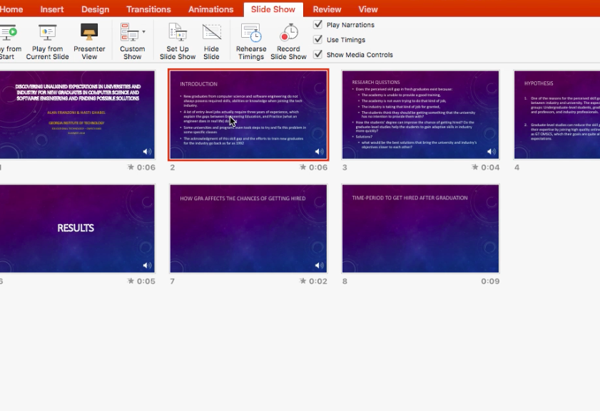
Go to Slide Show tab.
Select the slide you want to save narration recording.
Click Record Slide Show.

Slide 2
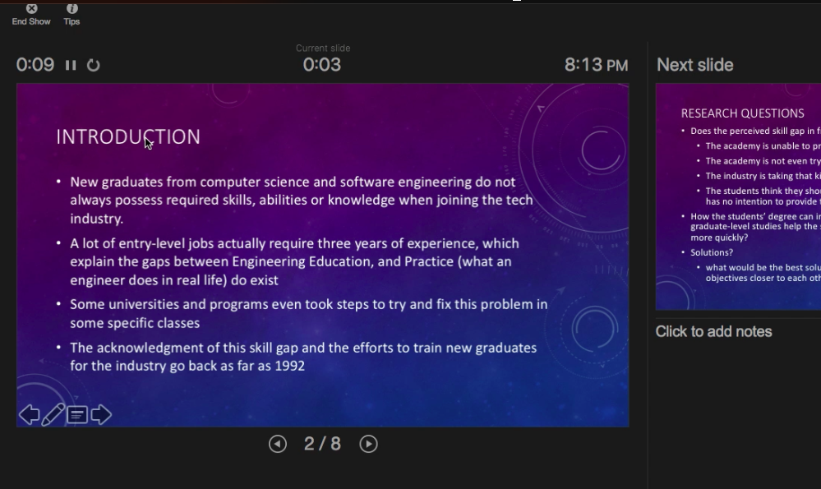
Start recording your voice.
Then click pause.
Click End Show to Save

Slide 3
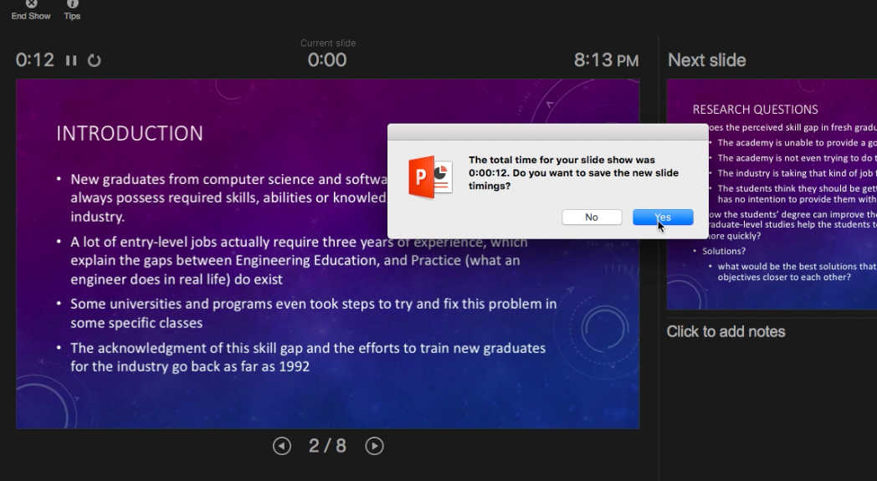
Click Save to complete slide recording

